Slide 1




Slide 2



Slide 3


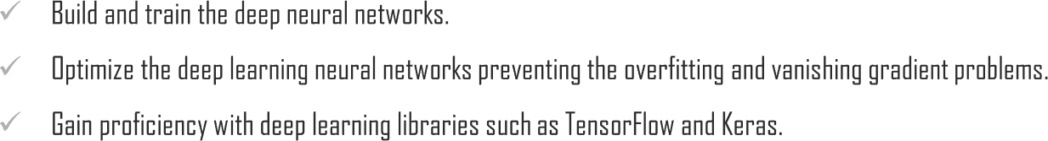


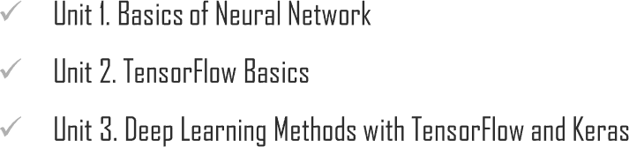
Chapter Description

Slide 4


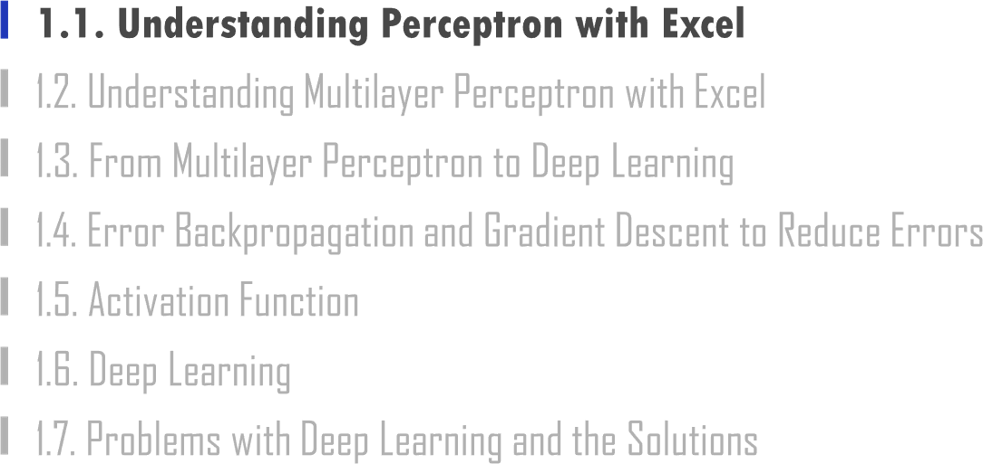

Slide 5


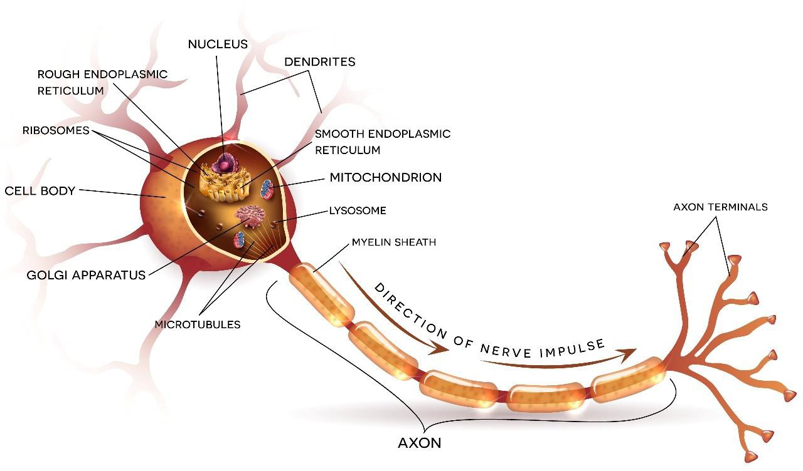
1.1. Understanding Perceptron with Excel
UNIT 01

Slide 6
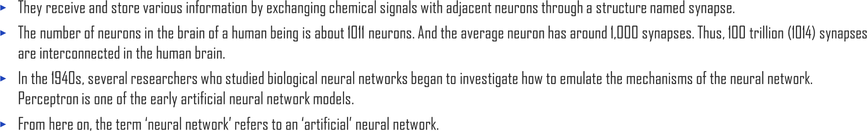

1.1. Understanding Perceptron with Excel
UNIT 01

Slide 7

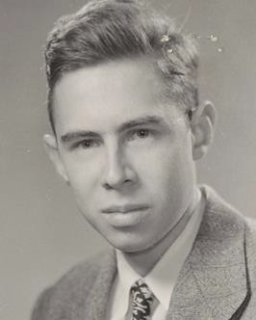
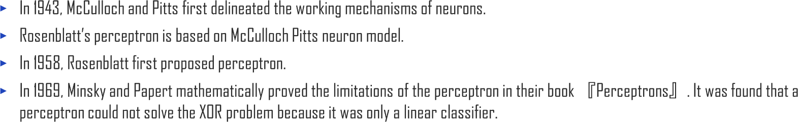
1.1. Understanding Perceptron with Excel
UNIT 01
Frank Rosenblatt
(1928~1971)

Slide 8





1.1. Understanding Perceptron with Excel
UNIT 01
Input
Output
𝜒₀ = 1
𝜒₁
𝑊₀
𝑊₁
𝑊₂
𝜒₂
_{y}
𝑊_{𝑑}
𝜒_{𝑑}
Structure of a perceptron

Slide 9

1.1. Understanding Perceptron with Excel
UNIT 01
X1 | X2 | OR operation
False | False | F
True | False | T
False | True | T
True | True | T

Slide 10
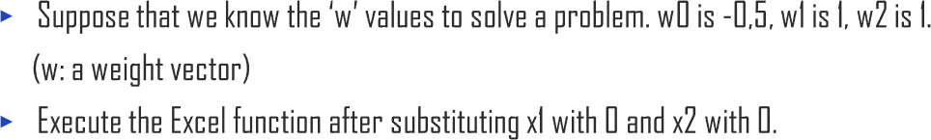
1.1. Understanding Perceptron with Excel
UNIT 01
x1 | X2
0 | 0
w0 | w1 | w2
-0.5 | 1 | 1
1
1
x0
w0
x0 * w0 | -0.5
+
x1
0
0
w1
-0.5
x0 * w1 | 0
+
x0 * w2 | 0
w2
Sum | -0.5
x2
0
0

Slide 11

1.1. Understanding Perceptron with Excel
UNIT 01
𝑦=𝜏(𝑠)
1
𝑠
−1
Use a threshold function as an activation function 𝜏(s).

Slide 12


1.1. Understanding Perceptron with Excel
UNIT 01
A threshold can be defined as follows,
𝑦 = 𝜏 𝑠
𝑑
𝑠 | 𝜏(𝑠)
-100 | -1
-90 | -1
-80 | -1
-70 | -1
-60 | -1
-50 | -1
-40 | -1
-30 | -1
-20 | -1
-10 | -1
0 | 1
10 | 1
20 | 1
30 | 1
40 | 1
50 | 1
60 | 1
70 | 1
80 | 1
90 | 1
100 | 1
Threshold function
Here,
𝑠 ≥ 0ൢ
−1 𝑠 < 0
here 𝑠 = 𝑤₀ + ෍ 𝑤_{𝑖}𝑥_{𝑖} ,
𝜏 𝑠 = ቊ ¹
𝑖=1

Slide 13
1.1. Understanding Perceptron with Excel
UNIT 01
A truth table displays truth or false for all results of the propositions or the combination of their Boolean functions.
For example, in conjunction with statements P and Q 𝑃⋀𝑄, the truth table can be constructed as below.
In addition, true∙false is also notated as T∙F or 1∙0.
Proposition P | Proposition Q | 𝑷 ∧ 𝑸
True | True | True
True | False | False
False | True | False
False | False | False

Slide 14
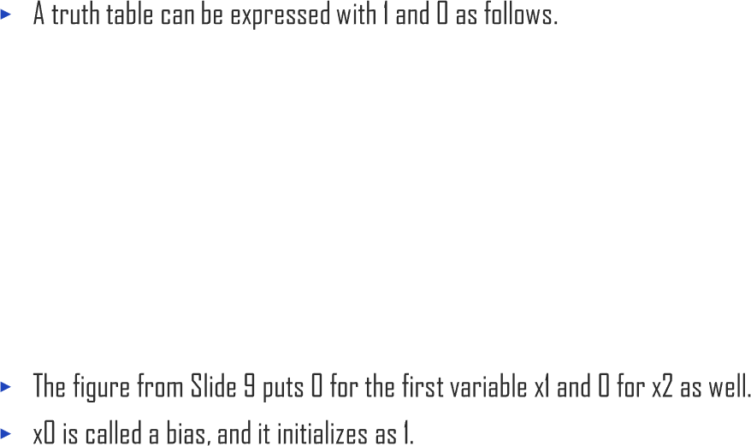
1.1. Understanding Perceptron with Excel
UNIT 01
x1 | x2
0 | 0
1 | 0
0 | 1
1 | 1

Slide 15

1.1. Understanding Perceptron with Excel
UNIT 01
The bias is generally fixed as 1.
1
0
-0.5
0

Slide 16

1.1. Understanding Perceptron with Excel
UNIT 01
The bias is generally fixed as 1.
-0.5
 |  | 𝑠 | 𝜏 𝑠
0 | 0 | -0.5 | -1
1 | 0 | 0.5 | 1
0 | 1 | 0.5 | 1
1 | 1 | 1.5 | 1

Slide 17









1.1. Understanding Perceptron with Excel
UNIT 01
 |  | 𝑠 | 𝜏 𝑠
0 | 0 | -0.5 | -1
1 | 0 | 0.5 | 1
0 | 1 | 0.5 | 1
1 | 1 | 1.5 | 1

Slide 18









1.1. Understanding Perceptron with Excel
UNIT 01
 |  | 𝑠 | 𝜏 𝑠
0 | 0 | -0.5 | -1
1 | 0 | 0.5 | 1
0 | 1 | 0.5 | 1
1 | 1 | 1.5 | 1

Slide 19






1.1. Understanding Perceptron with Excel
UNIT 01
0 | 0 | 0 | =$A$2*$C$7+B2*$C$8+C2*$C$9 | =IF(D2>=0,1,-1)
 | 0 | 1 | =$A$2*$C$7+B3*$C$8+C3*$C$9 | =IF(D3>=0,1,-1)
 | 1 | 0 | =$A$2*$C$7+B4*$C$8+C4*$C$9 | =IF(D4>=0,1,-1)
 | 1 | 1 | =$A$2*$C$7+B8*$C$8+C5*$C$9 | =IF(D5>=0,1,-1)
-0.5
1
1
𝑥₁ =
0
0
, 𝑦₁ = −1 , 𝑥₂ =
1
0
, 𝑦₂ = 1 , 𝑥₃ =
0
1
, 𝑦₃ = 1 , 𝑥₄ =
1
1
, 𝑦₄ = 1
Example of a perceptron’s operation using the OR logic gate

Slide 20
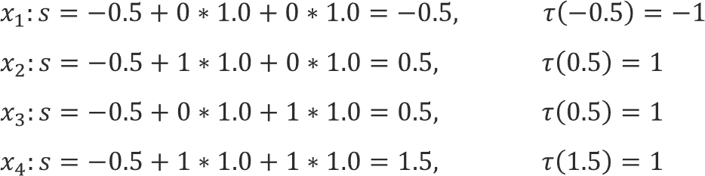
1.1. Understanding Perceptron with Excel
UNIT 01

Slide 21








1.1. Understanding Perceptron with Excel
UNIT 01
0 | 0 | F
1 | 0 | F
0 | 1 | F
1 | 1 | T

Slide 22


1.1. Understanding Perceptron with Excel
UNIT 01
The bias is generally fixed as 1.
-0.5
 |  | 𝑠 | 𝜏 𝑠
0 | 0 | 0.5 | 1
1 | 0 | 0 | 1
0 | 1 | 0.4 | 1
1 | 1 | -0.1 | -1

Slide 23

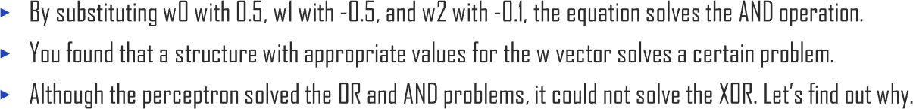
1.1. Understanding Perceptron with Excel
UNIT 01
The bias is generally fixed as 1.
-0.5
 |  | 𝑠 | 𝜏 𝑠
0 | 0 | 0.5 | 1
1 | 0 | 0 | 1
0 | 1 | 0.4 | 1
1 | 1 | -0.1 | -1

Slide 24

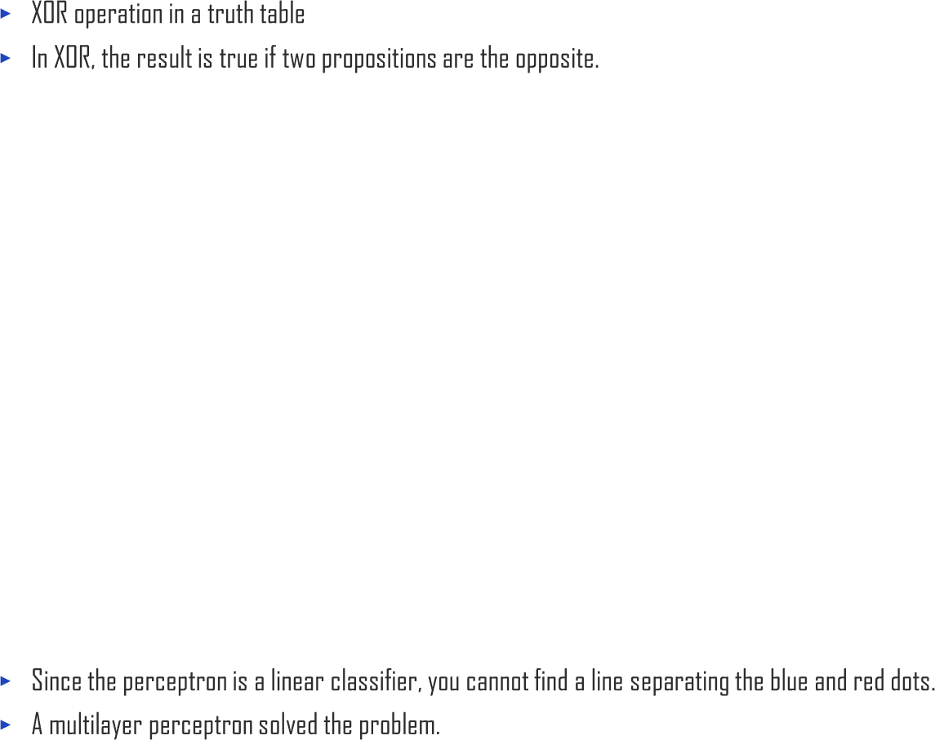






1.1. Understanding Perceptron with Excel
UNIT 01
0 | 0 | F
1 | 0 | T
0 | 1 | T
1 | 1 | F

Slide 25
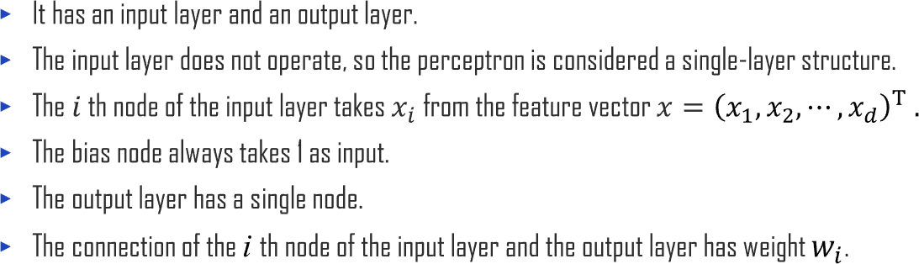








1.1. Understanding Perceptron with Excel
UNIT 01
Mechanism of a perceptron

Slide 26
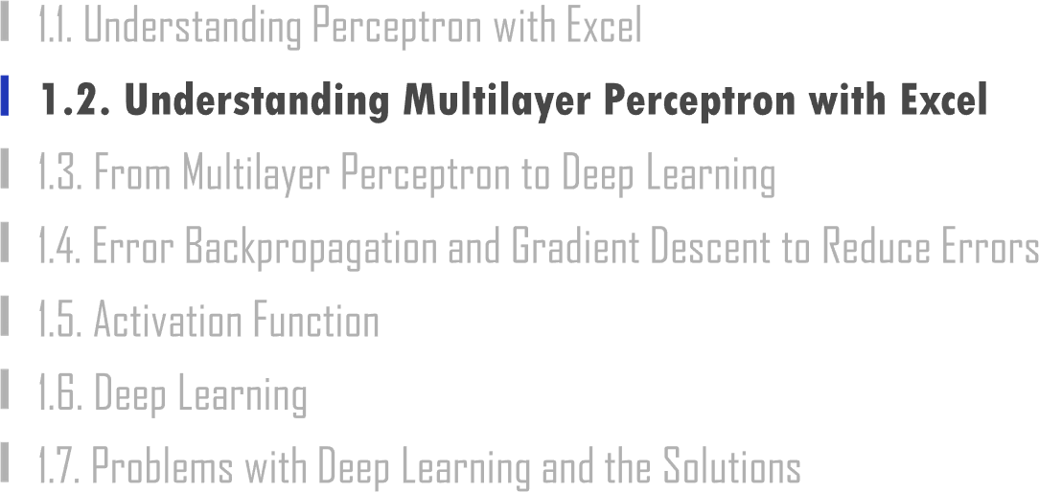

Slide 27

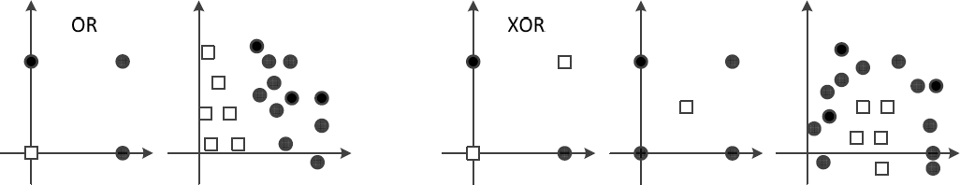
1.2. Understanding Multilayer Perceptron with Excel
UNIT 01
Linearly separable case and linearly inseparable case
OR
XOR
(a) Linearly separable
(b) Linearly inseparable

Slide 28


1.2. Understanding Multilayer Perceptron with Excel
UNIT 01
This was claimed by Marvin Minsky, an MIT professor who was the pioneer of the AI field, in his book <Perceptrons>, published in 1969.
→ People realized that emulating the diagram of ‘neuron → neural network → intelligence’ through the diagram of ‘perceptron → artificial neural network → artificial intelligence’ was not an easy task.
After this publication, research on AI took a downturn.
After 10 years, this problem was solved by a ‘multilayer’ perceptron.

Slide 29
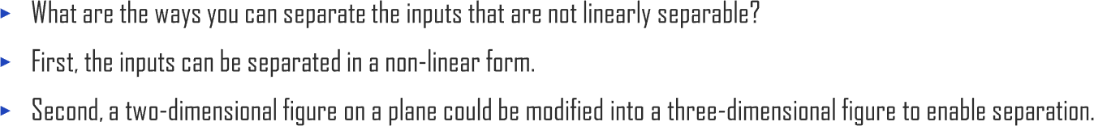
1.2. Understanding Multilayer Perceptron with Excel
UNIT 01

Slide 30

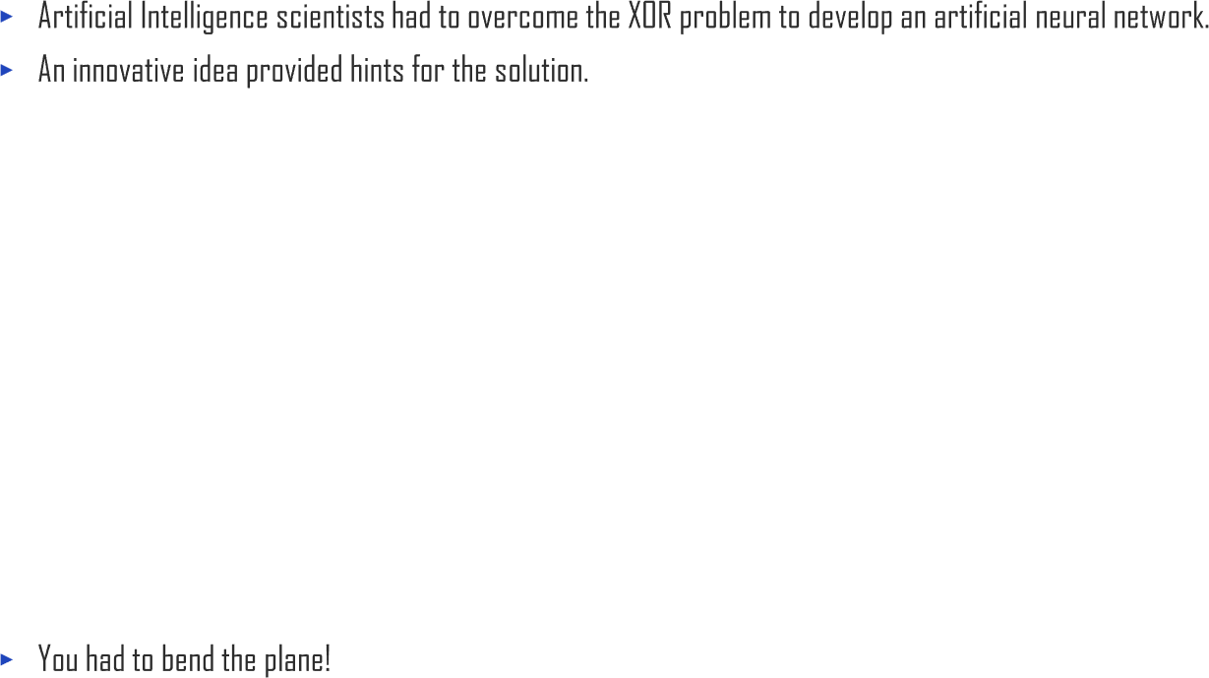
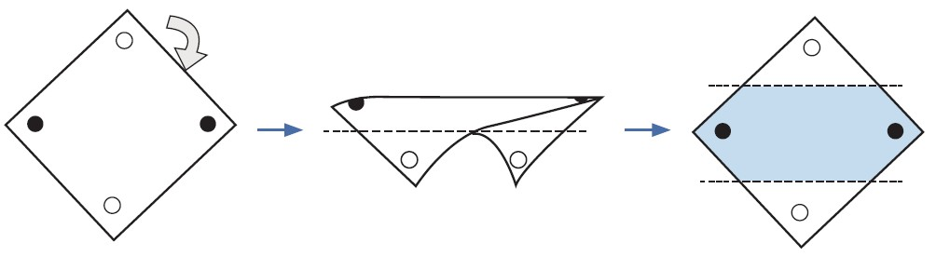
1.2. Understanding Multilayer Perceptron with Excel
UNIT 01

Slide 31
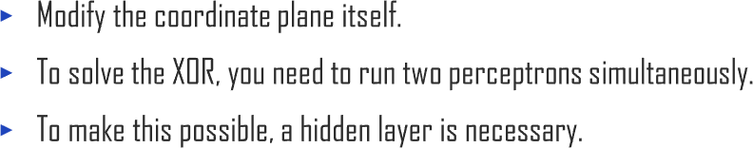
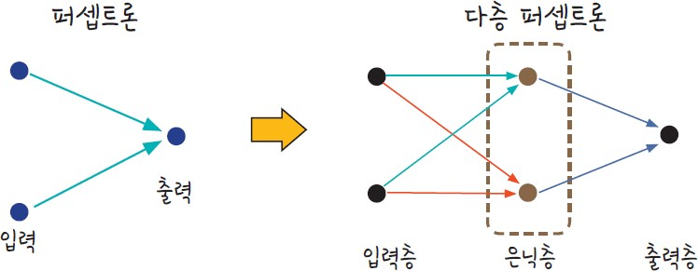
1.2. Understanding Multilayer Perceptron with Excel
UNIT 01
Perceptron to Multilayer Perceptron
Perceptron
Multilayer Perceptron
Output
Input
Hidden layer
Output layer
Input layer

Slide 32
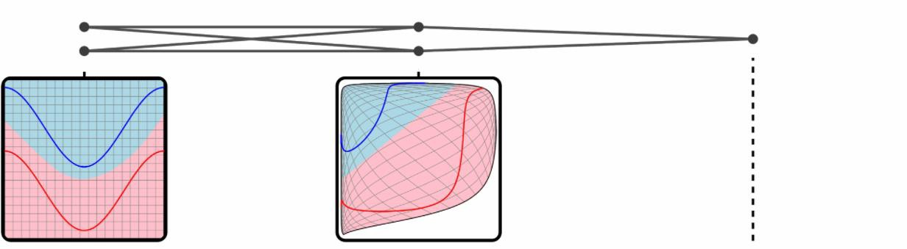
1.2. Understanding Multilayer Perceptron with Excel
UNIT 01
Perceptron to Multilayer Perceptron
Input
(2)
hidden
(2 sigmoid)
output
(1 sigmoid)

Slide 33
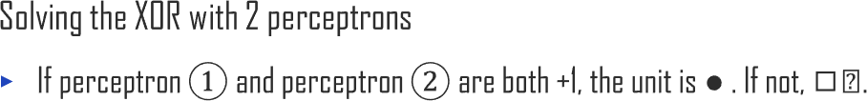







1.2. Understanding Multilayer Perceptron with Excel
UNIT 01
Solution for the XOR problem

Slide 34
1.2. Understanding Multilayer Perceptron with Excel
UNIT 01
Solving XOR
Sigmoid function
=1/(1+exp(-x))
b1
Hidden layer
n1
b2
Input layer
x1
Output layer
W1
W2
^{y}out
x2
n2
0 | 0
0 | 1
1 | 0
1 | 1
-1 | 0.268941 | 0
1 | 0.731059 | 1
1 | 0.731059 | 1
3 | 0.952574 | 1
-1 | 0.268941 | 0
1 | 0.731059 | 1
1 | 0.731059 | 1
3 | 0.952574 | 1
-2
0
0
2
1
1
1
-2
1
1
1
2
0
0
0 | 0 | 0 | 0 | 1 |  | 0 | 1 | 0
0 | 1 | 1 | 0 | 1 |  | 1 | 1 | 1
1 | 0 | 1 | 0 | 1 |  | 1 | 1 | 1
1 | 1 | 1 | 1 | 0 |  | 1 | 0 | 0
3
-1
-1

Slide 35
1.2. Understanding Multilayer Perceptron with Excel
UNIT 01
Solving XOR
Hidden layer n
b1
b2
Input layer x
Output layer
W1
W2
^{y}out
x
n
0 | 0
0 | 1
1 | 0
1 | 1
=C12*$F$12+D12*$F$14+$F$18 | =1/(1+EXP(-K12)) | 1
=C13*$F$12+D13*$F$14+$F$18 | =1/(1+EXP(-K13)) | 1
=C14*$F$12+D14*$F$14+$F$18 | =1/(1+EXP(-K14)) | 1
=C15*$F$12+D15*$F$14+$F$18 | =1/(1+EXP(-K15)) | 0
=C12*$F$13+D12*$F$15+$F$19 | =1/(1+EXP(-O12)) | 0
=C13*$F$13+D13*$F$15+$F$19 | =1/(1+EXP(-O13)) | 1
=C14*$F$13+D14*$F$15+$F$19 | =1/(1+EXP(-O14)) | 1
=C15*$F$13+D14*$F$15+$F$19 | =1/(1+EXP(-O15)) | 1
-2
2
1
-2
1
2
0 | 0 | 0 | 0 | 1
0 | 1 | 1 | 0 | 1
1 | 0 | 1 | 0 | 1
1 | 1 | 1 | 1 | 0
3
-1
0
1
1
1
0
1
-1
1
1
1
0
1
0

Slide 36
1.2. Understanding Multilayer Perceptron with Excel
UNIT 01
Solving XOR
Hidden layer n
b1
b2
Output layer
Input layer x
W1
W2
^{y}out
x
n
0 | 0
0 | 1
1 | 0
1 | 1
=C12*$F$12+D12*$F$14+$F$18 | =1/(1+EXP(-K12)) | 1
=C13*$F$12+D13*$F$14+$F$18 | =1/(1+EXP(-K13)) | 1
=C14*$F$12+D14*$F$14+$F$18 | =1/(1+EXP(-K14)) | 1
=C15*$F$12+D15*$F$14+$F$18 | =1/(1+EXP(-K15)) | 0
=C12*$F$13+D12*$F$15+$F$19 | =1/(1+EXP(-O12)) | 0
=C13*$F$13+D13*$F$15+$F$19 | =1/(1+EXP(-O13)) | 1
=C14*$F$13+D14*$F$15+$F$19 | =1/(1+EXP(-O14)) | 1
=C15*$F$13+D14*$F$15+$F$19 | =1/(1+EXP(-O15)) | 1
-2
2
1
-2
1
2
0 | 0 | 0 | 0 | 1
0 | 1 | 1 | 0 | 1
1 | 0 | 1 | 0 | 1
1 | 1 | 1 | 1 | 0
3
-1
0
1
1
1
0
1
-1
1
1
1
0
1
0

Slide 37
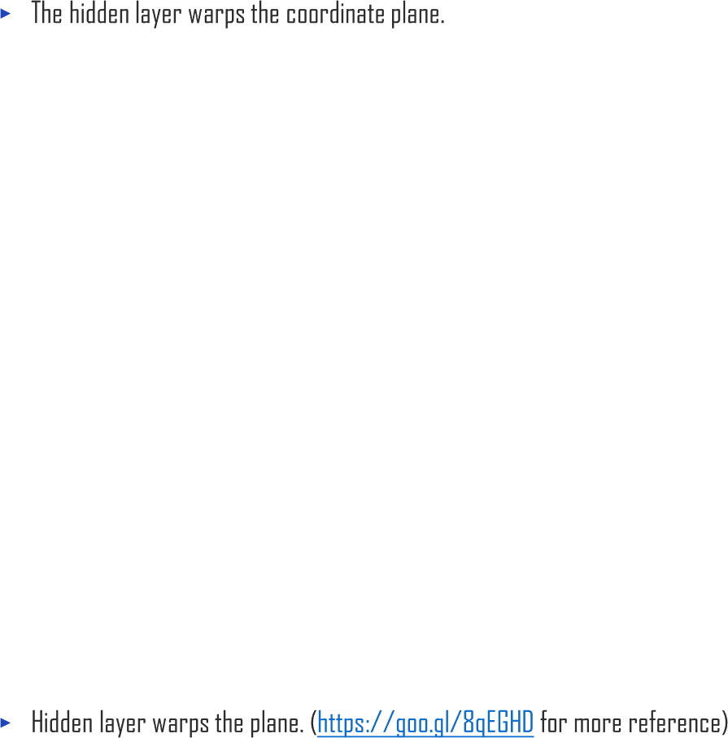
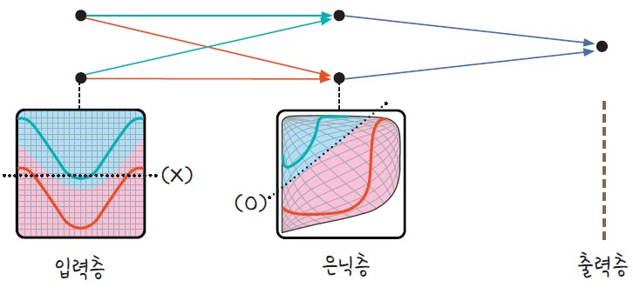
1.2. Understanding Multilayer Perceptron with Excel
UNIT 01
0 | 0 | 0 | 0 | 1 | 0 | 1 | 0
0 | 1 | 1 | 0 | 1 | 1 | 1 | 1
1 | 0 | 1 | 0 | 1 | 1 | 1 | 1
1 | 1 | 1 | 1 | 0 | 1 | 0 | 0
Input layer
Hidden layer
Output layer

Slide 38

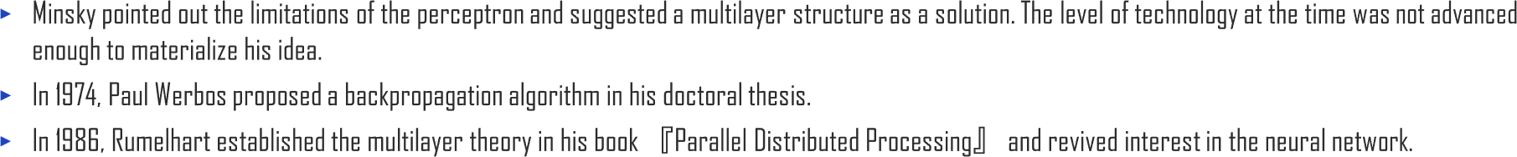
1.2. Understanding Multilayer Perceptron with Excel
UNIT 01

Slide 39
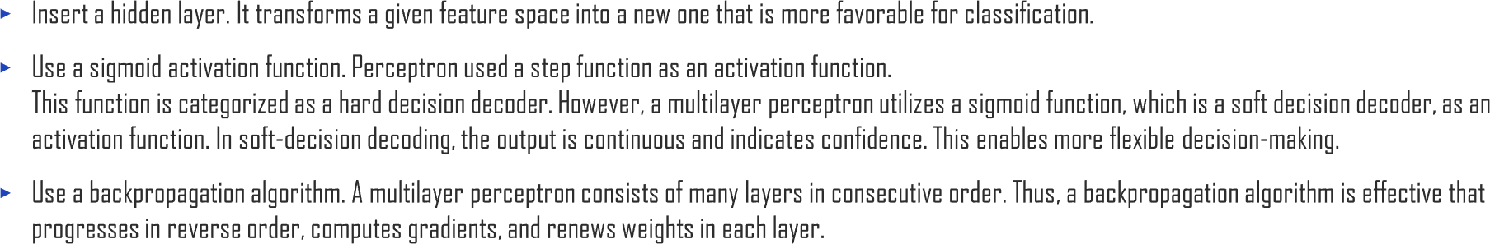
1.2. Understanding Multilayer Perceptron with Excel
UNIT 01

Slide 40
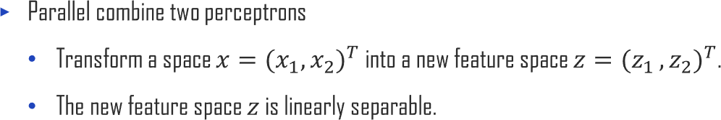







1.2. Understanding Multilayer Perceptron with Excel
UNIT 01
Transformation of a feature space

Slide 41




1.2. Understanding Multilayer Perceptron with Excel
UNIT 01
Multilayer Perceptron

Slide 42


1.2. Understanding Multilayer Perceptron with Excel
UNIT 01
Activation function used in neural network

Slide 43
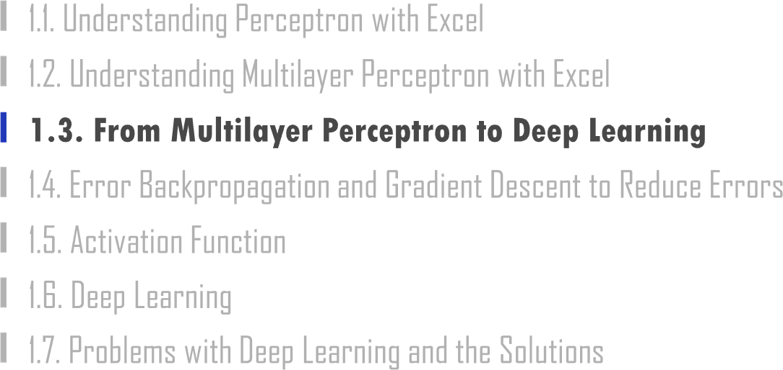

Slide 44



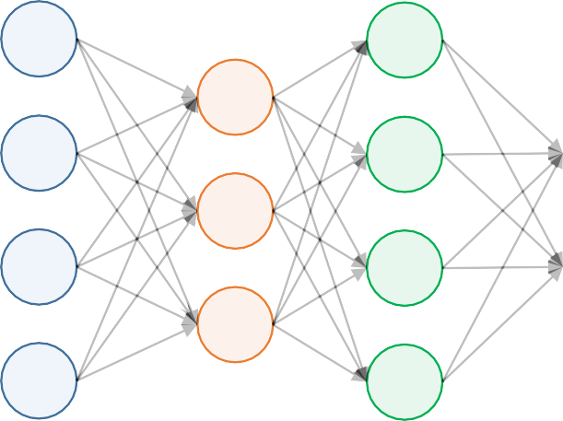



1.3. From Multilayer Perceptron to Deep Learning
UNIT 01

Slide 45
1.3. From Multilayer Perceptron to Deep Learning
UNIT 01

Slide 46
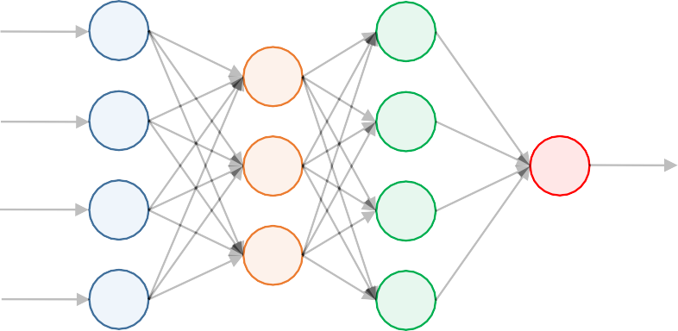
1.3. From Multilayer Perceptron to Deep Learning
UNIT 01
Example
𝑏₁, 𝑏₂, 𝑏₃
𝑥₁ ^{𝑤}11
^{𝑤}21
^{𝑤}31
^{𝑤}12
^{𝑤}22
^{𝑤}32
^{𝑤}13
^{𝑤}23
^{𝑤}33
𝑤
1
𝑥₁
𝑥₂
_{𝑥}1
𝑥
2
3
_{𝑥}1
𝑤
14
24
3
𝑥
4
^{𝑤}34
_{𝑥}1
𝑤
𝑤
𝑤
𝑤
𝑥₁
𝑥₂
𝑥
𝑏
1
11
12
13
14
1
_{𝑥}1
= 𝐴𝑐𝑡𝑖𝑣𝑎𝑡𝑖𝑜𝑛
^{𝑤}21 ^{𝑤}22 ^{𝑤}23 ^{𝑤}24
𝑤 𝑤 𝑤 𝑤
∙
+ 𝑏₂
𝑏₃
2
3
4
_{𝑥}1
31
32
33
34
𝑥
3

Slide 47
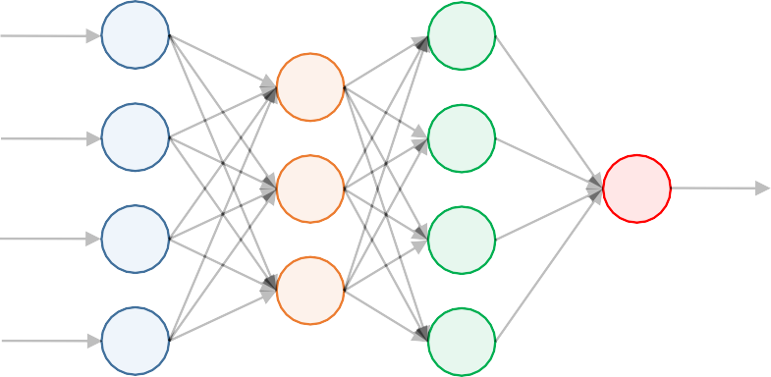
1.3. From Multilayer Perceptron to Deep Learning
UNIT 01
Example
𝑏₁, 𝑏₂,𝑏₃,𝑏₄
^{𝑤}11
^{𝑤}12
^{𝑤}13
^{𝑤}21
^{𝑤}22
^{𝑤}23
_{𝑥}2
_{𝑥}1
1
1
2
𝑥₂
_{𝑥}1
2
𝑤
𝑤
31
_{𝑥}2
32
3
1
^{𝑤}33
𝑤
𝑥₃
𝑤
42
41
^{𝑤}43 _{𝑥}2
4
_{𝑥}2
𝑤
𝑤
𝑤
𝑏
1
1
1
_{𝑥}2
11
12
13
𝑥₁
𝑏₂
𝑏₃
𝑏₄
2
= 𝐴𝑐𝑡𝑖𝑣𝑎𝑡𝑖𝑜𝑛
^{𝑤}21 ^{𝑤}22 ^{𝑤}23
^{𝑤}31 ^{𝑤}32 ^{𝑤}33
𝑤 𝑤 𝑤
1
+
_{𝑥}2
𝑥₂
3
_{𝑥}1
_{𝑥}2
42
42
43
3
4

Slide 48
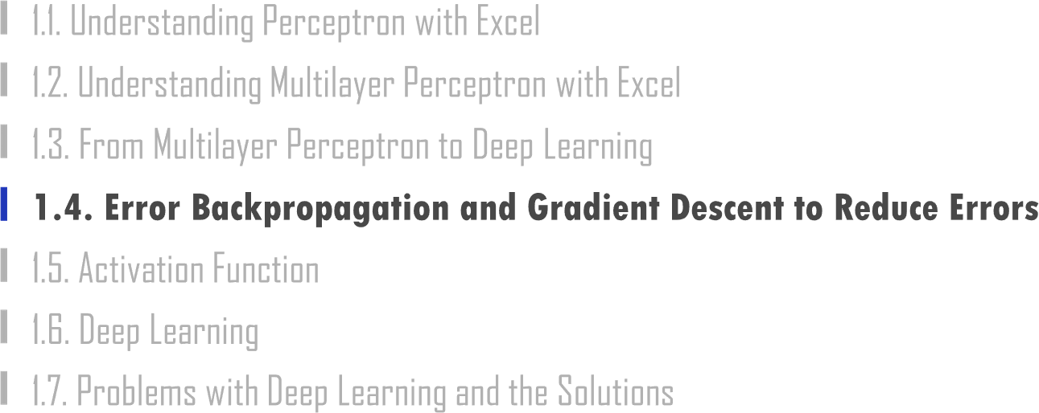

Slide 49
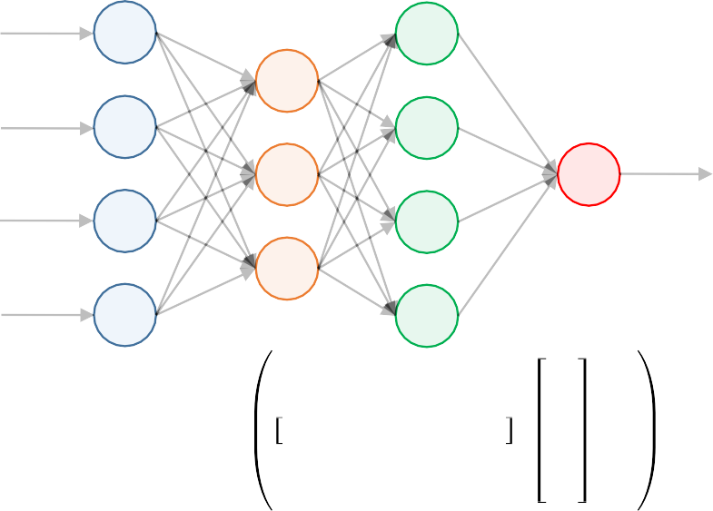
1.4. Error Backpropagation and Gradient Descent to Reduce Errors
UNIT 01
Example
𝑏
_{𝑥}2
1
𝑤₁
_{𝑥}2
𝑤₂
2
𝑦ො
≅ 𝑦?
Error = 𝑦 − 𝑦ො
_{𝑥}2
𝑤₃
3
_{𝑥}2
𝑤₄
4
_{𝑥}2
1
_{𝑥}2
𝑦ො = 𝐴𝑐𝑡𝑖𝑣𝑎𝑡𝑖𝑜𝑛
𝑤₁ 𝑤₂ 𝑤₃ 𝑤₄
∙
2
+ b
_{𝑥}2
3
_{𝑥}2
4

Slide 50
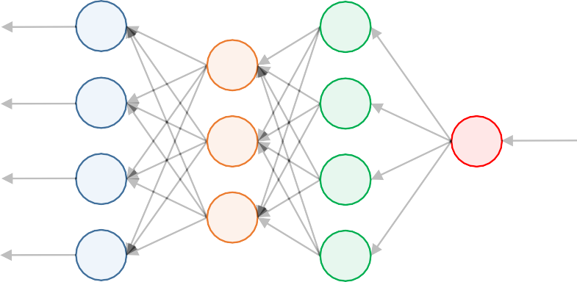

1.4. Error Backpropagation and Gradient Descent to Reduce Errors
UNIT 01
Example
𝑊← 𝑊 − 𝜂 𝜵𝐿oss
𝑏 ← 𝑏 − 𝜂 𝜵𝐿oss

Slide 51
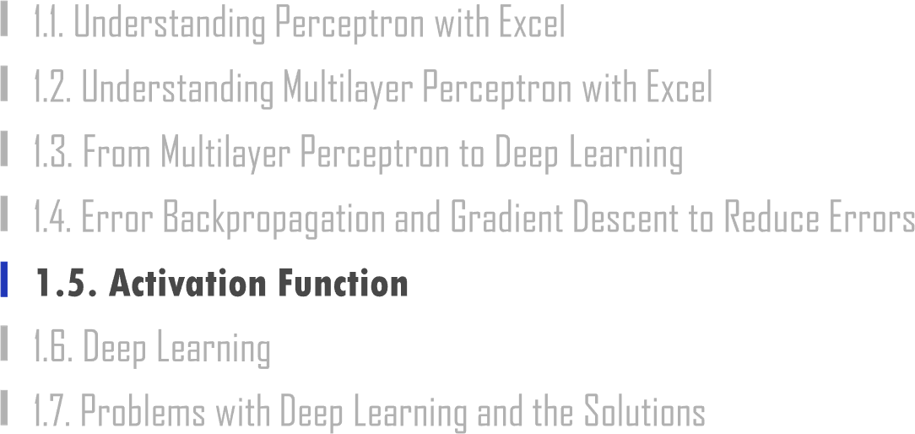

Slide 52

1.5. Activation Function
UNIT 01
An activation function that was frequently used in the early days of neural networks is the step function.

Slide 53
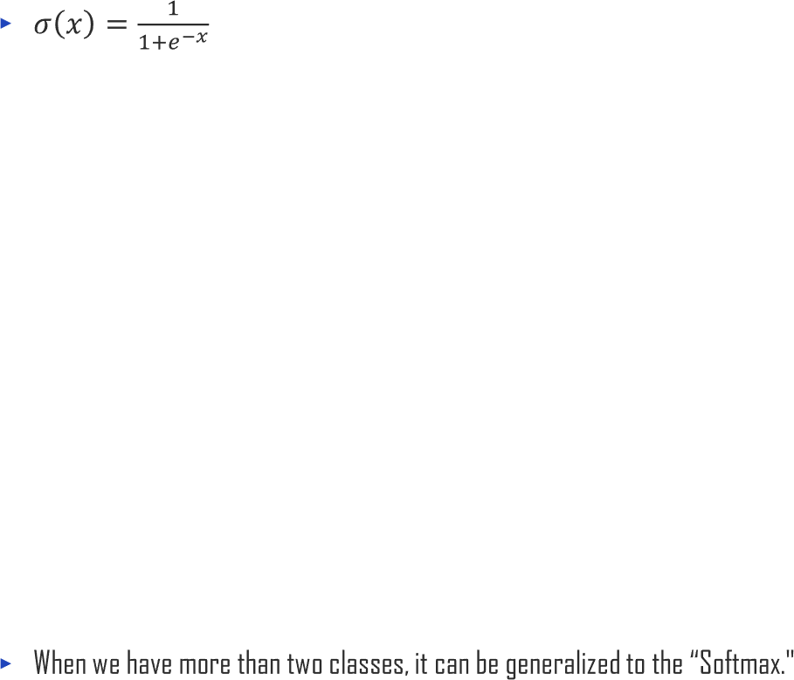


1.5. Activation Function
UNIT 01
The Sigmoid is another widely used activation function. Note that the output value ranges between 0 and 1.
+1
0
𝑥

Slide 54



1.5. Activation Function
UNIT 01
The hyperbolic tangent (tanh) looks similar to the Sigmoid. However, the output value ranges between -1 and +1.
+1
0
-1

Slide 55


1.5. Activation Function
UNIT 01
The linear activation’s output is the same as the input. The linear activation function is used in the regression.
0
𝑥

Slide 56

1.5. Activation Function
UNIT 01
0
𝑥

Slide 57

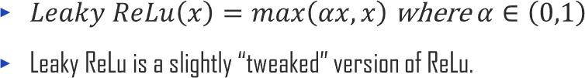

1.5. Activation Function
UNIT 01
0
𝑥

Slide 58





1.5. Activation Function
UNIT 01
This summarizes some of the most commonly used activation functions.
Softmax is often used at the output layer of neural networks that do classification.
Name | Formula | TensorFlow
Step | 𝑆𝑡𝑒𝑝 𝑥 = 𝜃 𝑥 − 𝑥₀ | 𝑡𝑓. 𝑚𝑎𝑡ℎ. 𝑠𝑖𝑔𝑛 𝑥 − 𝑥₀ + 1 2
Sigmoid | 1 𝜎 𝑥 = 1 + 𝑒^{−𝑥} | tf.math.sigmoid(x)
Tanh | _{𝑒}𝑥 _{− 𝑒}−𝑥 tanh 𝑥 = _{𝑒𝑥 + 𝑒−𝑥} | tf.math.tanh(x)
ReLu | 𝑅𝑒𝐿𝑢 𝑥 = max(0, 𝑥) | tf.nn.relu(x)
Softmax | _{𝑒}𝑥_{𝑗} 𝜎(𝑥)_{𝑗} = _{σ𝐾 𝑒𝑥𝑘} 𝑘=1 | tf.nn.softmax(x)

Slide 59
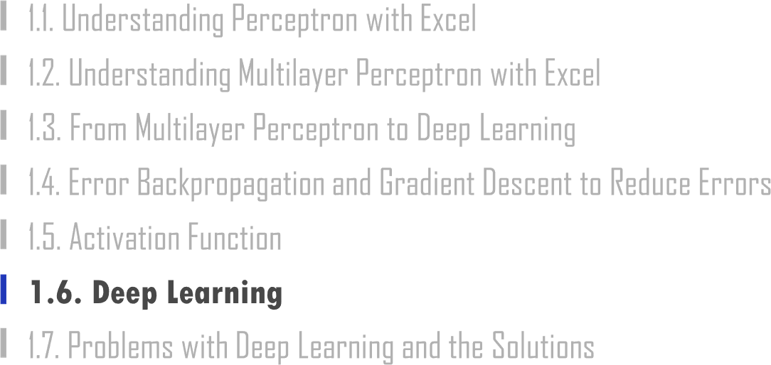

Slide 60
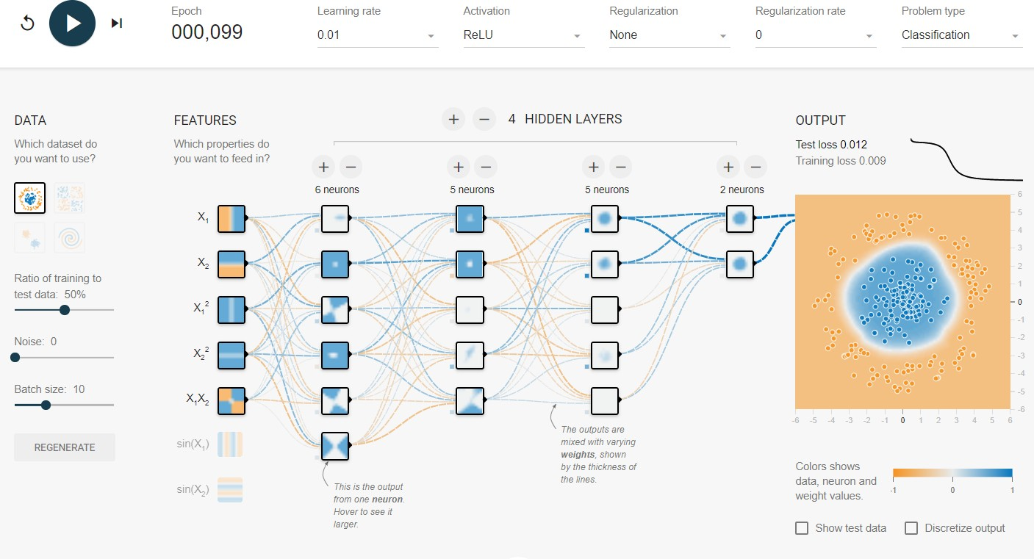
1.6. Deep Learning
UNIT 01

Slide 61
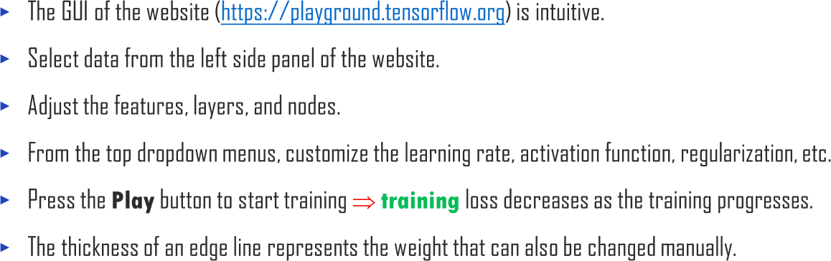
1.6. Deep Learning
UNIT 01

Slide 62
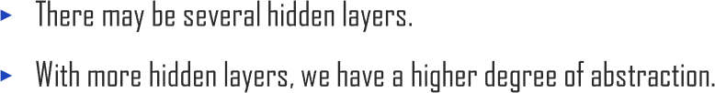



1.6. Deep Learning
UNIT 01
⋯
𝑋
⋯
𝑌
⋯

Slide 63
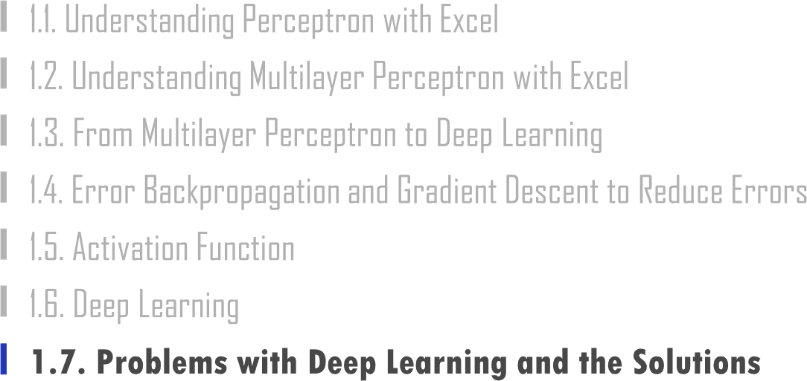

Slide 64
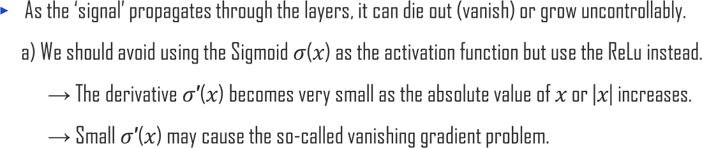



1.7. Problems of Deep Learning and the Solution
UNIT 01
𝜎 𝑥
𝜎′ 𝑥
+1
0
𝑥

Slide 65
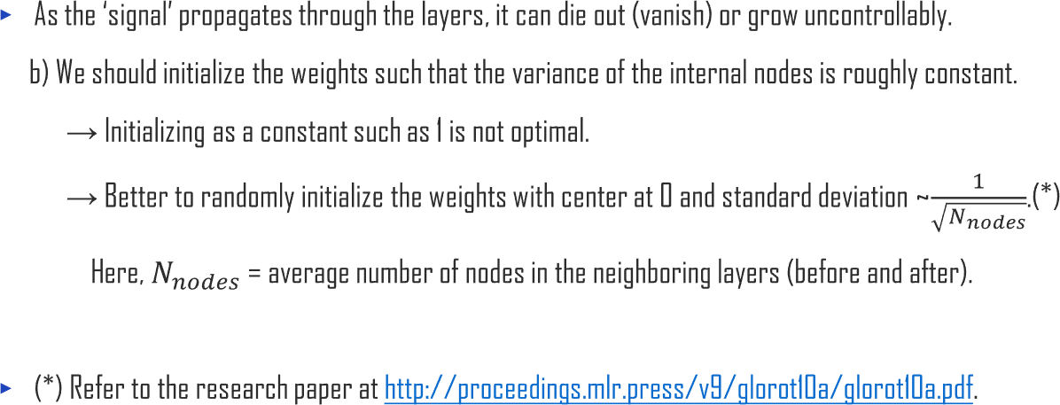
1.7. Problems of Deep Learning and the Solution
UNIT 01

Slide 66
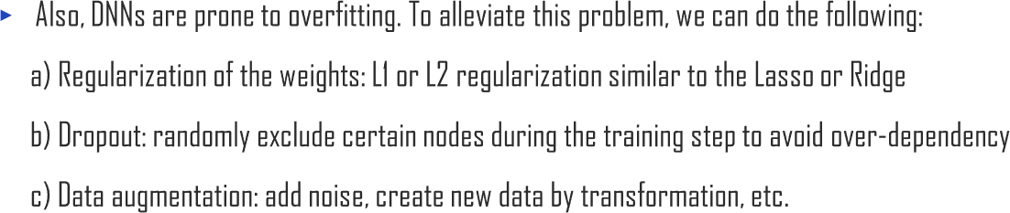
1.7. Problems of Deep Learning and the Solution
UNIT 01

Slide 67






1.7. Problems of Deep Learning and the Solution
UNIT 01

Slide 68



1.7. Problems of Deep Learning and the Solution
UNIT 01

Slide 69
1.7. Problems of Deep Learning and the Solution
UNIT 01

Slide 70



Slide 71
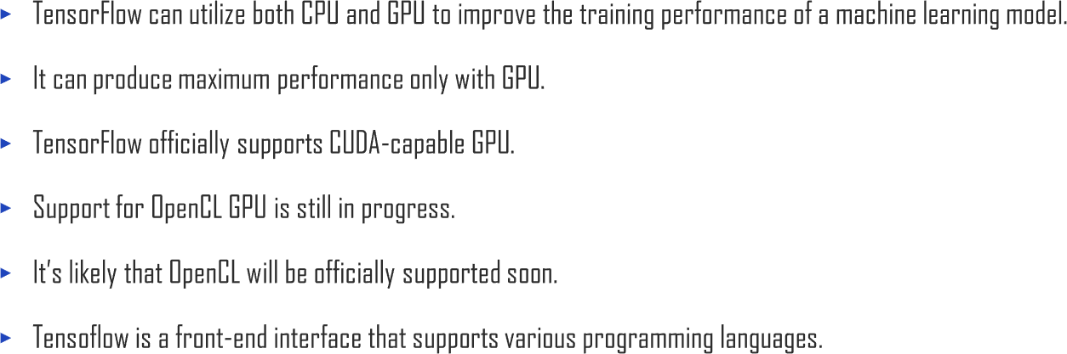

2.1. Introduction to TensorFlow
UNIT 02

Slide 72
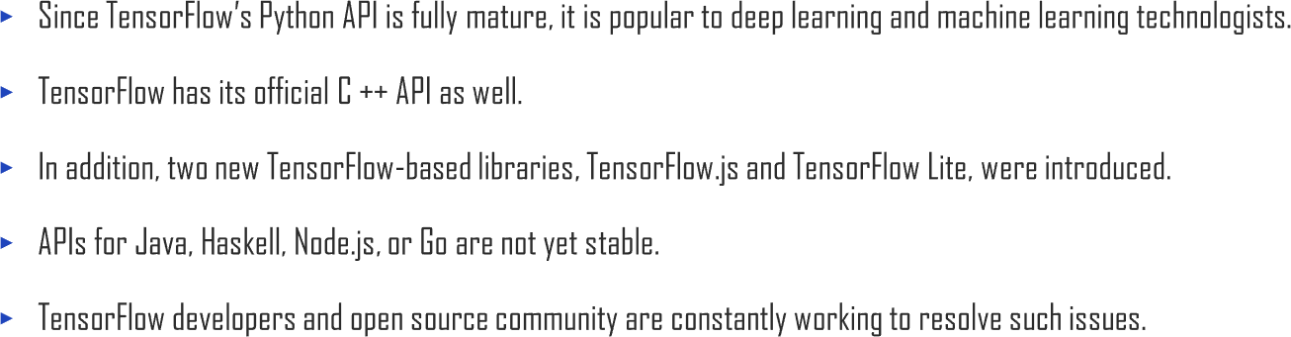
2.1. Introduction to TensorFlow
UNIT 02

Slide 73
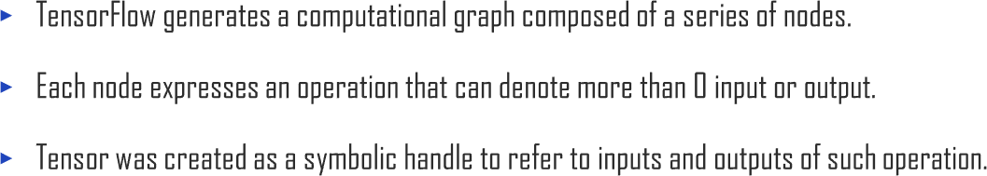
2.1. Introduction to TensorFlow
UNIT 02

Slide 74

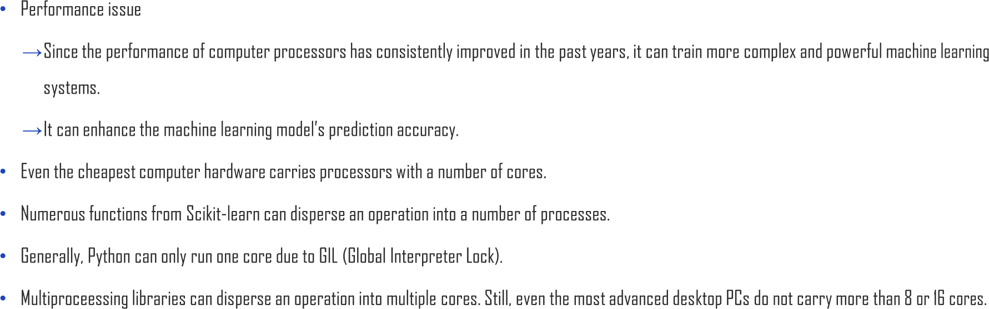
2.1. Introduction to TensorFlow
UNIT 02

Slide 75
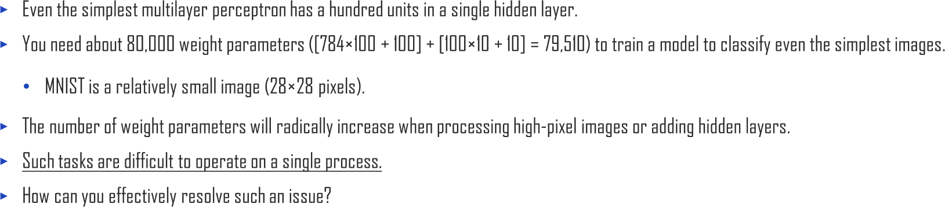
2.1. Introduction to TensorFlow
UNIT 02

Slide 76

2.1. Introduction to TensorFlow
UNIT 02

Slide 77




2.1. Introduction to TensorFlow
UNIT 02
Ex

Slide 78

2.1. Introduction to TensorFlow
UNIT 02

Slide 79

2.1. Introduction to TensorFlow
UNIT 02

Slide 80

2.1. Introduction to TensorFlow
UNIT 02

Slide 81



2.1. Introduction to TensorFlow
UNIT 02
> pip install tensorflow
> pip install tensorflow==[desired-version]

Slide 82


2.1. Introduction to TensorFlow
UNIT 02

Slide 83

2.1. Introduction to TensorFlow
UNIT 02
> pip install tensorflow-gpu

Slide 84


2.1. Introduction to TensorFlow
UNIT 02

Slide 85

2.1. Introduction to TensorFlow
UNIT 02

Slide 86

2.1. Introduction to TensorFlow
UNIT 02

Slide 87


2.1. Introduction to TensorFlow
UNIT 02

Slide 88


2.1. Introduction to TensorFlow
UNIT 02
Ex

Slide 89

2.1. Introduction to TensorFlow
UNIT 02

Slide 90

2.1. Introduction to TensorFlow
UNIT 02

Slide 91

2.1. Introduction to TensorFlow
UNIT 02

Slide 92

2.1. Introduction to TensorFlow
UNIT 02

Slide 93

2.1. Introduction to TensorFlow
UNIT 02

Slide 94


2.1. Introduction to TensorFlow
UNIT 02

Slide 95

2.1. Introduction to TensorFlow
UNIT 02

Slide 96

2.1. Introduction to TensorFlow
UNIT 02

Slide 97


2.1. Introduction to TensorFlow
UNIT 02

Slide 99

2.2. TensorFlow dataset
UNIT 02

Slide 100


2.2. TensorFlow dataset
UNIT 02

Slide 101


2.2. TensorFlow dataset
UNIT 02

Slide 102

2.2. TensorFlow dataset
UNIT 02
batch
batch
batch
batch

Slide 103

2.2. TensorFlow dataset
UNIT 02

Slide 104

2.2. TensorFlow dataset
UNIT 02
## Step 1

Slide 105

2.2. TensorFlow dataset
UNIT 02
## Step 1

Slide 106

2.2. TensorFlow dataset
UNIT 02
## Step 2

Slide 107

2.2. TensorFlow dataset
UNIT 02
## Step 2

Slide 108

2.2. TensorFlow dataset
UNIT 02
## Step 3

Slide 109

2.2. TensorFlow dataset
UNIT 02

Slide 110

2.2. TensorFlow dataset
UNIT 02
'Image Size:

Slide 111

2.2. TensorFlow dataset
UNIT 02
Image size: Image size: Image size: Image size: Image size: Image size:

Slide 112

2.2. TensorFlow dataset
UNIT 02

Slide 113

2.2. TensorFlow dataset
UNIT 02

Slide 114

2.2. TensorFlow dataset
UNIT 02

Slide 115

2.2. TensorFlow dataset
UNIT 02

Slide 116

2.2. TensorFlow dataset
UNIT 02

Slide 117

2.2. TensorFlow dataset
UNIT 02

Slide 118


2.2. TensorFlow dataset
UNIT 02

Slide 119

2.2. TensorFlow dataset
UNIT 02

Slide 120

2.2. TensorFlow dataset
UNIT 02

Slide 121

2.2. TensorFlow dataset
UNIT 02

Slide 122

2.2. TensorFlow dataset
UNIT 02

Slide 123

2.2. TensorFlow dataset
UNIT 02

Slide 124

2.2. TensorFlow dataset
UNIT 02

Slide 125

2.2. TensorFlow dataset
UNIT 02

Slide 126

2.2. TensorFlow dataset
UNIT 02

Slide 127

2.2. TensorFlow dataset
UNIT 02

Slide 128


Slide 129






2.3. Machine Learning with TensorFlow
UNIT 02
Code
Code
Multi-backend Keras
tf.keras

Slide 130

2.3. Machine Learning with TensorFlow
UNIT 02

Slide 131









2.3. Machine Learning with TensorFlow
UNIT 02

Slide 132

2.3. Machine Learning with TensorFlow
UNIT 02

Slide 133



2.3. Machine Learning with TensorFlow
UNIT 02
𝑆 = 𝑏 + 𝑤₁𝑋₁ + 𝑤₂𝑋₂ + ⋯ + 𝑤_{𝑘}𝑋_{𝑘}
_{𝑒} 𝑆
𝜎 𝑆 =
1 + 𝑒 ^{𝑆}

Slide 134








2.3. Machine Learning with TensorFlow
UNIT 02

Slide 135

2.3. Machine Learning with TensorFlow
UNIT 02
𝑛
− ෍ 𝐿𝑜𝑔 1 + 𝑒^{−𝑦𝑖 𝑆}
𝑖=1
1
𝑛
𝐿 = − ෍ 𝑦_{𝑖}𝑙𝑜𝑔 𝑝ෝ _{𝑖} + 1 − 𝑦_{𝑖} 𝑙𝑜𝑔(1 − 𝑝ෝ _{𝑖})
𝑛
𝑖=1

Slide 136





























2.3. Machine Learning with TensorFlow
UNIT 02

Slide 137


2.3. Machine Learning with TensorFlow
UNIT 02

Slide 138



2.3. Machine Learning with TensorFlow
UNIT 02

Slide 139

2.3. Machine Learning with TensorFlow
UNIT 02

Slide 140

















2.3. Machine Learning with TensorFlow
UNIT 02

Slide 141









2.3. Machine Learning with TensorFlow
UNIT 02

Slide 142


2.3. Machine Learning with TensorFlow
UNIT 02

Slide 143

2.3. Machine Learning with TensorFlow
UNIT 02

Slide 144

2.3. Machine Learning with TensorFlow
UNIT 02

Slide 145

2.3. Machine Learning with TensorFlow
UNIT 02

Slide 146





Slide 147
3.1. Main Features of TensorFlow
UNIT 03

Slide 148

3.1. Main Features of TensorFlow
UNIT 03

Slide 149

3.1. Main Features of TensorFlow
UNIT 03

Slide 150








3.1. Main Features of TensorFlow
UNIT 03
tf.keras tf.estimator
tf.distribute tf.saved_model tf.autograph tf.graph_util tf.lite tf.quantization tf.tpu
tf.xla
tf.nn tf.losses tf.metrics tf.optimizers tf.train
tf.initializers
tf.lookup tf.nest tf.ragged tf.sets tf.sparse th.strings
tf.GradientTape tf.gradients ()
tf.data tf.feature_colum n
tf.audio tf.image tf.io tf.queue
tf.math tf.linalg tf.signal tf.random tf.bitwise
tf.compat tf.config &more
tf.summary

Slide 151


Slide 152


3.2. Keras Basics
UNIT 03

Slide 153




3.2. Keras Basics
UNIT 03
High level APIs
Framework Linear Algebra, Math
Hardware

Slide 154





3.2. Keras Basics
UNIT 03

Slide 155




3.2. Keras Basics
UNIT 03

Slide 156






3.2. Keras Basics
UNIT 03
 | 𝑛 𝐿 = ෍ 𝑦_{𝑖} − 𝑦ෝ _{𝑖} ² 𝑖=1
 | 𝑛 𝐿 = ෍ 𝑦_{𝑖} − 𝑦ෝ _{𝑖} 𝑖=1
 | 𝑛 1 𝐿 = − ෍ 𝑦_{𝑖} 𝑙𝑜𝑔 𝑝ෝ _{𝑖} + 1 − 𝑦_{𝑖} 𝑙𝑜𝑔(1 − 𝑝ෝ _{𝑖}) 𝑛 𝑖=1
 | 𝑛 𝐾 1 𝐿 = − ෍ ෍ 𝑦_{𝑖𝑘} 𝑙𝑜𝑔 𝑝ෝ _{𝑖𝑘} 𝑛 𝑖=1 𝑘=1

Slide 157











3.2. Keras Basics
UNIT 03

Slide 158




3.2. Keras Basics
UNIT 03
 | 𝑙𝑖𝑛𝑒𝑎𝑟 𝑥 = 𝑥
 | 1 𝜎 𝑥 = 1 + 𝑒^{−𝑥}
 | _{𝑒}𝑥 _{− 𝑒}−𝑥 𝑡𝑎𝑛ℎ(𝑥) = _{𝑒𝑥 + 𝑒−𝑥}
 | 𝑅𝑒𝐿𝑢(𝑥) = max(0, 𝑥)
 | _{𝑒}𝑥_{𝑗} 𝜎(𝒙)_{𝑗} = _{σ𝐾 𝑒𝑥𝑘} 𝑘=1

Slide 159
















3.2. Keras Basics
UNIT 03

Slide 160

3.2. Keras Basics
UNIT 03

Slide 161




3.2. Keras Basics
UNIT 03

Slide 162


Slide 163











3.3. AI with Keras
UNIT 03

Slide 164


3.3. AI with Keras
UNIT 03

Slide 165




3.3. AI with Keras
UNIT 03

Slide 166

3.3. AI with Keras
UNIT 03

Slide 167


3.3. AI with Keras
UNIT 03
Line 91
Add an output layer for linear regression.
Line 92
Summary of the model

Slide 168

3.3. AI with Keras
UNIT 03
Line 93
Hyperparameters
Line 94
Define the optimizer and then compile.

Slide 169

3.3. AI with Keras
UNIT 03
Line 95
verbose = 0 means no output. verbose = 1 to view the epochs.
Line 96
View the keys.

Slide 170

3.3. AI with Keras
UNIT 03
Line 97-1
Skip the first few steps.

Slide 171
3.3. AI with Keras
UNIT 03
Training History
Train
Validation
100
80
60
40
20
0 250 500 750 1000 1250 1500 1750
Epoch
MSE

Slide 172



3.3. AI with Keras
UNIT 03
Line 100
Returns the 0 = loss value and 1 = metrics value.

Slide 173
3.3. AI with Keras
UNIT 03

Slide 174

3.3. AI with Keras
UNIT 03
Line 102-1
Input layer
Line 102-2
Output layer

Slide 175


3.3. AI with Keras
UNIT 03

Slide 176
3.3. AI with Keras
UNIT 03
Line 105
Loss = MAE (L1) and Metrics = MSE (L2)

Slide 177
3.3. AI with Keras
UNIT 03

Slide 178

3.3. AI with Keras
UNIT 03
Training History
Train
Validation
100
80
60
40
20
0 250 500 750 1000 1250 1500 1750
Epoch
MSE

Slide 179

3.3. AI with Keras
UNIT 03
Line 109
Returns the 0 = loss value and 1 = metrics value.

Slide 180


3.3. AI with Keras
UNIT 03

Slide 181


3.3. AI with Keras
UNIT 03

Slide 182


3.3. AI with Keras
UNIT 03

Slide 183
3.3. AI with Keras
UNIT 03

Slide 184

3.3. AI with Keras
UNIT 03
Line 123
Add layers to a Sequential object.
units = N# of output variables
Line 124
Summary of the model

Slide 185

3.3. AI with Keras
UNIT 03

Slide 186

3.3. AI with Keras
UNIT 03
Line 128
Verbose = 0 means no output. Verbose = 1 to view the epochs.
Line 129
View the keys.

Slide 187

3.3. AI with Keras
UNIT 03

Slide 188

3.3. AI with Keras
UNIT 03

Slide 189











3.3. AI with Keras
UNIT 03
Convolution layer
Pooling layer
Dropout layer
Fully connected layer

Slide 190


3.3. AI with Keras
UNIT 03

Slide 191



3.3. AI with Keras
UNIT 03

Slide 192


3.3. AI with Keras
UNIT 03
Line 135-1
You may change this at will.

Slide 193



3.3. AI with Keras
UNIT 03

Slide 194

3.3. AI with Keras
UNIT 03

Slide 195


3.3. AI with Keras
UNIT 03
Line 140-1
1 channel of grayscale

Slide 196


3.3. AI with Keras
UNIT 03

Slide 197

3.3. AI with Keras
UNIT 03

Slide 198

3.3. AI with Keras
UNIT 03
Line 144
verbose = 0 means no output. verbose = 1 to view the epochs.

Slide 199

3.3. AI with Keras
UNIT 03
Training History
0.99
0.98
0.97
0.96
0.95
Accuracy
Train Validation
0.94
0
2
4
Epoch
6 8

Slide 200
3.3. AI with Keras
UNIT 03

Slide 201

3.3. AI with Keras
UNIT 03

Slide 202

3.3. AI with Keras
UNIT 03

Slide 203

3.3. AI with Keras
UNIT 03

Slide 204

3.3. AI with Keras
UNIT 03

Slide 205

3.3. AI with Keras
UNIT 03
Line 155
3 channels of color

Slide 206

3.3. AI with Keras
UNIT 03

Slide 207

3.3. AI with Keras
UNIT 03

Slide 208

3.3. AI with Keras
UNIT 03
Line 159
verbose = 0 means no output. verbose = 1 to view the epochs.

Slide 209

3.3. AI with Keras
UNIT 03
Training History
0.8
0.7
0.6
0.5
Accuracy
Train Validation
0.0 2.5 5.0 7.5 10.0 12.5 15.0 17.5
Epoch
0.4

Slide 210
3.3. AI with Keras
UNIT 03

Slide 211




















3.3. AI with Keras
UNIT 03

Slide 212







3.3. AI with Keras
UNIT 03

Slide 213



3.3. AI with Keras
UNIT 03

Slide 214
3.3. AI with Keras
UNIT 03
10
8
6
4
2
0 5 10 15 20 25 30 35 40

Slide 215

3.3. AI with Keras
UNIT 03
Data Fit
10
8
6
4
2
0
10
20
30
40
50

Slide 216


3.3. AI with Keras
UNIT 03
1.0
0.8
0.6
0.4
0.2
0.0
0 5 10 15 20 25 30 35 40

Slide 217
3.3. AI with Keras
UNIT 03

Slide 218


3.3. AI with Keras
UNIT 03
Line 170-2
There is only 1 time series data. No other choice but 1.

Slide 219
3.3. AI with Keras
UNIT 03
Line 171-1
Scalar input
Line 171-2
N# of neurons per layer
Line 171-3
Scalar output

Slide 220
3.3. AI with Keras
UNIT 03
Line 172
Return sequences = True: means “Sequence to Sequence."
Input shape = (None, n inputs): the variable length of the time series.

Slide 221

3.3. AI with Keras
UNIT 03

Slide 222
3.3. AI with Keras
UNIT 03

Slide 223

3.3. AI with Keras
UNIT 03
Line 176
No validation.
CAUTION: y is X shifted by +1.

Slide 224

3.3. AI with Keras
UNIT 03
Training History
1.4
1.2
1.0
0.8
0.6
0.4
0.2
0.0
MSE
Train
0 200 400 600 800 1000
Epoch

Slide 225
3.3. AI with Keras
UNIT 03
Line 180-1
Seed length
Line 180-2
Prediction length

Slide 226


3.3. AI with Keras
UNIT 03
Line 181-3
Reshape.
Line 181-5
The last output is the predicted y.

Slide 227

3.3. AI with Keras
UNIT 03
12
Data Fit
10
8
6
4
2
0
10
20
30
40
50
60

Slide 228



Slide 229


